Slide 1
Public appreciation of species diversity: Swiss findings and comparison with intuitions from the 2017 re-introduction of B. bison in western Canada
Paulina Naef and Cord Phelps

Slide 2
Introduction
Junge and Matthies have studied Swiss people’s attitude toward biodiversity in agricultural field margins. They conclude there is an awareness of biodiversity gradients that are appreciated by the local population.
Further, in a second study, they hypothesize that there may be an economic penalty associated with reduced tourism if the aesthetic contribution of biodiverse grasslands is not optimized.
Separately, a major ecological project in western Canada, the re-introduction of B. bison as a keystone species, may allow a slightly more nuanced assessment of public perception towards biodiversity.

Slide 3
Abstract
Are biodiversity and aesthetics valued separately by the public?
Does public appreciation for biodiversity and aesthetics manifest itself outside of Switzerland?
We examine the recent re-introduction of B. bison into western Canada to compare apparent public valuation of both “biodiversity” and “aesthetics” with the Junge’s enhanced field margin studies.
We then assess the Junge studies for variation between “biodiversity” and “aesthetic” benefits and compare the two experiences.

Slide 4
Background: Junge in Switzerland
Using grasses and forbs, experiments assessed the public’s ability to discern features of, and their preference for
Evenness (equality to species abundance) contrasted with species richness (166 visitors)
Various species spatial distributions or aggregation patterns (204 visitors)
Various degrees of species richness (288 visitors at a botanical garden)
Plus field studies of larger alpine meadow plots (282 tourists)
Content from only one paper; I need to add the other also…...
Result: diversity and aesthetics
Appreciation increases with true species richness
The appreciation of the best monoculture was always lower than the mean appreciation of the most species rich arrays.
“People found those communities most beautiful that were either most diverse or were perceived to be most diverse.”

Slide 5
Further study?
Relevance to the Banff experience?
We suspect that there may have been a wide cultural divergence in the 980 visitors sampled by Junge. Did they all share the same conception of beauty? Should the readers imagine that “ecosystem functioning” is the underlying driver of the aesthetic gradients that were expressed by the visitors?
We also expect that the unconscious perception of biodiversity does contribute to aesthetic assessment. The concept of Beauty has itself evolved to include more contextual components as noted by Stein and McMordie [ ] , suggesting that a landscape level architecture that is perceived to represent essential cultural “character” will be viewed as “beautiful”.
B. bison had been effectively extinct for 150 years until governments and private organizations turned their attention to conservation. News records related to the 2017 reintroduction of a herd in western Canada contain references to developing public values of “biodiversity” mixed with, or supported by, messages highlighting cultural “aesthetics”. Do these public messages allow a comparison of biodiversity and aesthetic values?

Slide 6
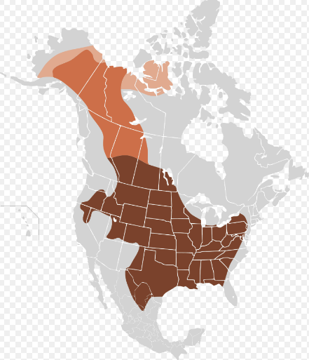
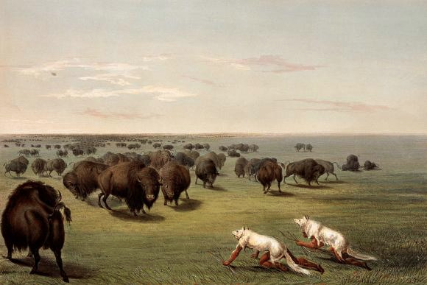
Background: Banff Reintroduction
Prior to Westward Expansion (~1800)
North American B. bison population estimated to be 30 million
Indigenous people depended on the bison for their way of life
[Buffalo Hunt, with Wolf-Skin Mask.] - George Catlin (1796-1872) | Amon Carter Museum of American Art
https://en.wikipedia.org/wiki/American_bison

Slide 7
1883: bison effectively extinct in South Saskatchewan (Canada)
1894: Unorganized Territories Game and Preservation Act
1907: 708 bison imported from Montana to Banff
Preservation focus
Banff Timeline
https://crowfootmedia.com/2015/03/29/bison-banff-national-park/
https://en.wikipedia.org/wiki/History_of_bison_conservation_in_Canada
2000: Canada National Parks Act: calls for the “restoration of ecological integrity”
2017: wild bison return to Banff
Conservation focus
2015: the Buffalo Treaty and funding from the Govt of Canada
Articulation of cultural benefits

Slide 8
Materials and Methods: design and data collection
We screen-scrape the public record related to the the 2017 re-introduction of B. bison in western Canada and assess the relative weights of messages, those of “biodiversity” and “aesthetics”, flowing to the media audience.
There was no attempt to randomize and sample our search results, our goal was to find at least 30, arguably unique, public news stories over the course of a year. Note that many news organizations, in writing an article, leverage a press release or “backgrounder” issued by the newsmaking organization. This means that certain statements, phrases, and quotes will be found repeated in different news articles. We believe this content is still relevant as unique data as its use should reflect the community attitude of the market that each news organization serves. [ ]
I need a source here

Slide 9
Materials and Methods: design and data collection (cont)
We count keyword occurrences, accumulate them into the two categories and produce a weighted snapshot for each observation

Slide 10
Keywords and Data consolidation
Conservation
Ecosystem / ecology
Environment
Biodiversity
Fence
Roam
Keystone
Icon(ic)
Species
“biodiversity”
First Nations
Indigenous
Aboriginal
Cultural
Spiritual
Mythic
Buffalo treaty
Aesthetic
“aesthetic”

Slide 11
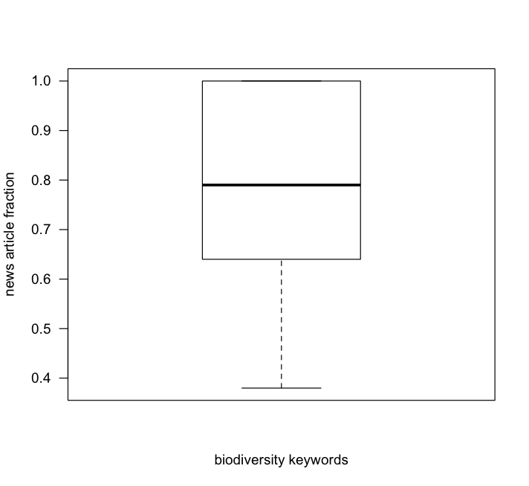
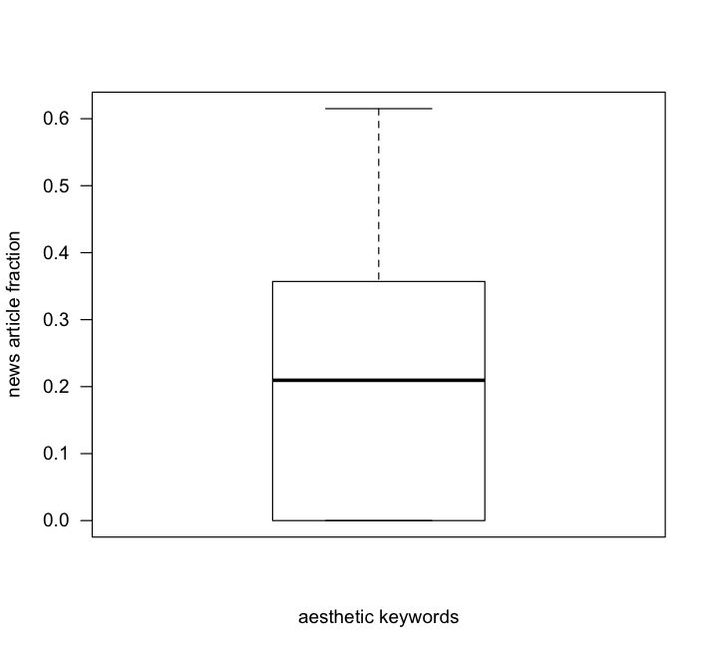
Results / Discussion

Slide 12
Conclusion
xxxxx

Slide 13
Thank you! Questions?

Slide 14
References
Beauty and Character: Values Beyond Beauty in Architecture | https://link.springer.com/article/10.1023/A:1016552320002
Splendid Isolation: Patterns of Geographic Range Collapse in Endangered Mammals Mark V. Lomolino and Rob Channell Journal of Mammalogy Vol. 76, No. 2 (May, 1995), pp. 335-347
Parks Canada Backgrounder | https://www.canada.ca/en/parks-canada/news/2017/02/bison_reintroduction.html?wbdisable=true

Slide 15
Links
Ensuring Ecological Integrity, the Reintroduction of North America’s Largest Land Animal | https://www.youtube.com/watch?v=4q1AudFTLEA
Project Data
Parks Canada: Bison 101 | https://www.pc.gc.ca/en/pn-np/ab/banff/info/gestion-management/bison/info

Slide 16
references
[ 1 ] http://www.pc.gc.ca/en/pn-np/ab/banff/info/gestion-management/bison
[2] http://calgaryherald.com/news/local-news/bringing-bison-back-to-banff-will-have-immediate-effect-on-birds-bugs-expert
[ 3 ] http://www.cbc.ca/news/canada/calgary/historic-treaty-signed-among-10-first-nations-and-tribes-in-banff-1.3190715

Slide 17
The Buffalo Treaty 2015 (3)
An alliance intended to engage tribes and First Nations in continuing dialogue on bison conservation
Uniting the political power of the tribes and First Nations of the Northern Great Plains
Advancing an international call for the restoration of the bison
Engaging youth in the treaty process
Strengthening and renewing ancient cultural and spiritual relationships with bison and grasslands in the Northern Great Plains

Slide 18
Data collection strategy and limitations
The event happened on
The park system issues a “backgrounder” containing scientific and operational details and quotes. Many of these were effectively “copy-pasted” into uniques news articles
So there is an element of repetition in the february march content
The First Nations peoples typically do not document their deliberations and opinions on the internet [ ] so this is one sided, repetitive data

Slide 19
Statistical Methods

Slide 20
Plains bison reintroduction (1)
Wild bison return to Canada’s first national park
On February 1, 2017, Parks Canada made history. After missing from the wild for over a century, 16 bison were successfully translocated to the Panther Valley, in Banff National Park.
Their homecoming is an ecological, historic and cultural triumph and coincides with the 150thanniversary of Canada’s confederation.
This is the first step in the five-year project to inform decisions regarding restoring wild bison in Banff over the long-term.

